Slide 1
Remembrance at ISP School, Battle

Slide 2
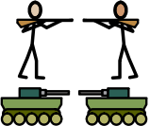
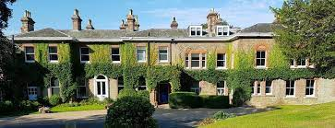

Slide 3
We can all trace people in our family who fought in wars, be that WWI, WWII or something more recent.
Today we will be thinking about the people linked to this building, our school, who made the greatest sacrifice of all, to ensure that we could live the lives we do today.
We will be thinking about the family who lived in Telham Court (what this building was called when it was a home).
We will also be remembering children - past students of Glengorse School, who also never came home from war.

Slide 4
Telham Court
Once upon a time, our school building was a house called Telham Court.
It was built in 1857.
In the 1871 census it was recorded as having 553 acres and employing 15 men and 16 boys.

Slide 5
1891 – The family

Slide 6
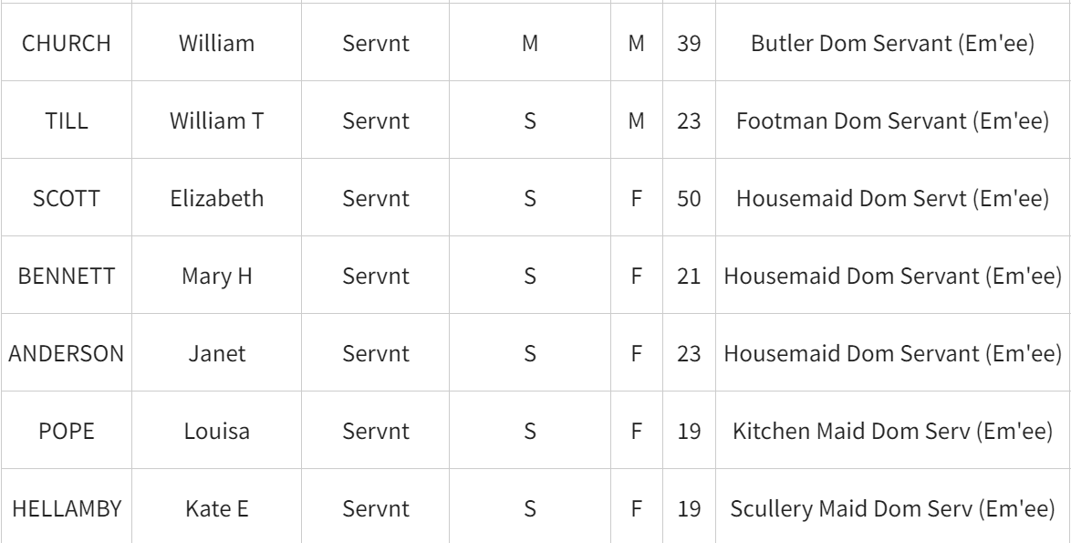
1891 – The Servants

Slide 7
1891 – The Servants Continued… (!)

Slide 8
We are starting by focusing on:
If he was 11 in 1891, how old was he at the start of WWI (1914)?

Slide 9
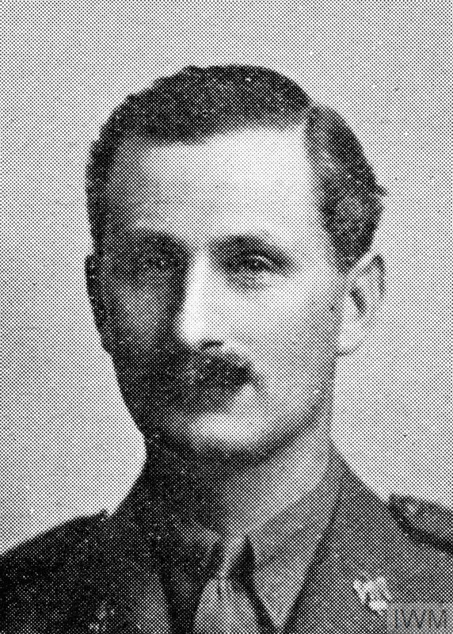
Here he is

Slide 10
This is his obituary (an obituary is an article written about you in the paper when you die).
It explains when he was born and where, where he went to school, what he enjoyed doing (cricket, hunting and shooting). It states that he joined the 1st Dragoons in 1899 and was in the South African War. For this he received the King’s Medal and the Queen’s Medal. He left the army for 3 years before the outbreak of WWI and re-joined in October 1914. he was in command of the regimental machine guns when he was killed – on the 13th May 1915.

Slide 11
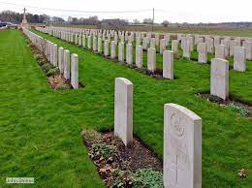
He is buried at Hop Store Cemetry, Ypres, Belgium – Plot I, Row D, Grave 17.

Slide 12
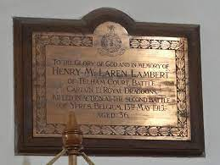
There is a memorial to him from his family at St Mary’s Church in Battle.

Slide 13
However, sadly, there is more to our remembrance than Captain Henry Talbot.
A number of past pupils of Glengorse school lost their lives both to WWI and WWII.

Slide 14
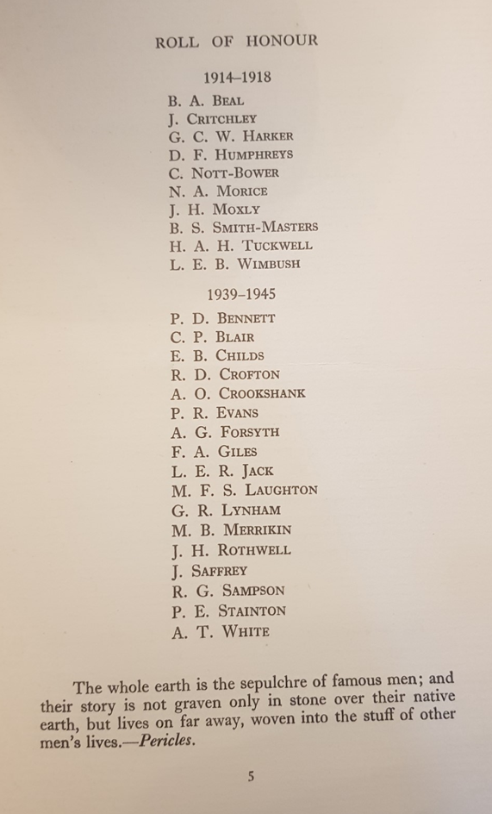

Slide 15
It was very important to the school to find a way of honouring their sacrifice. It was decided a chapel would be built in their memory.

Slide 16
It was very important to the school to find a way of honouring their sacrifice. It was decided a chapel would be built in their memory.
Fund raising started in 1945 – it was not until 1952 that the chapel was finally completed. This was because they raised the money to build the chapel through fund raisers such as the Christmas Fair and donations from parents (a donation was also made by the Lambert family). First came the building, followed by wooden pews, stained glass windows and wooden panelling.

Slide 17
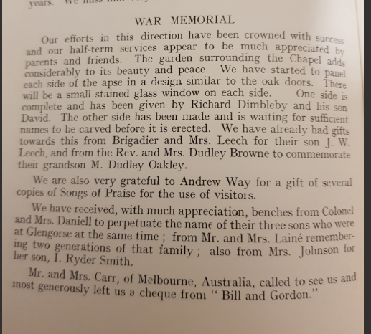
The Chapel’s Journey 1951-1952

Slide 18
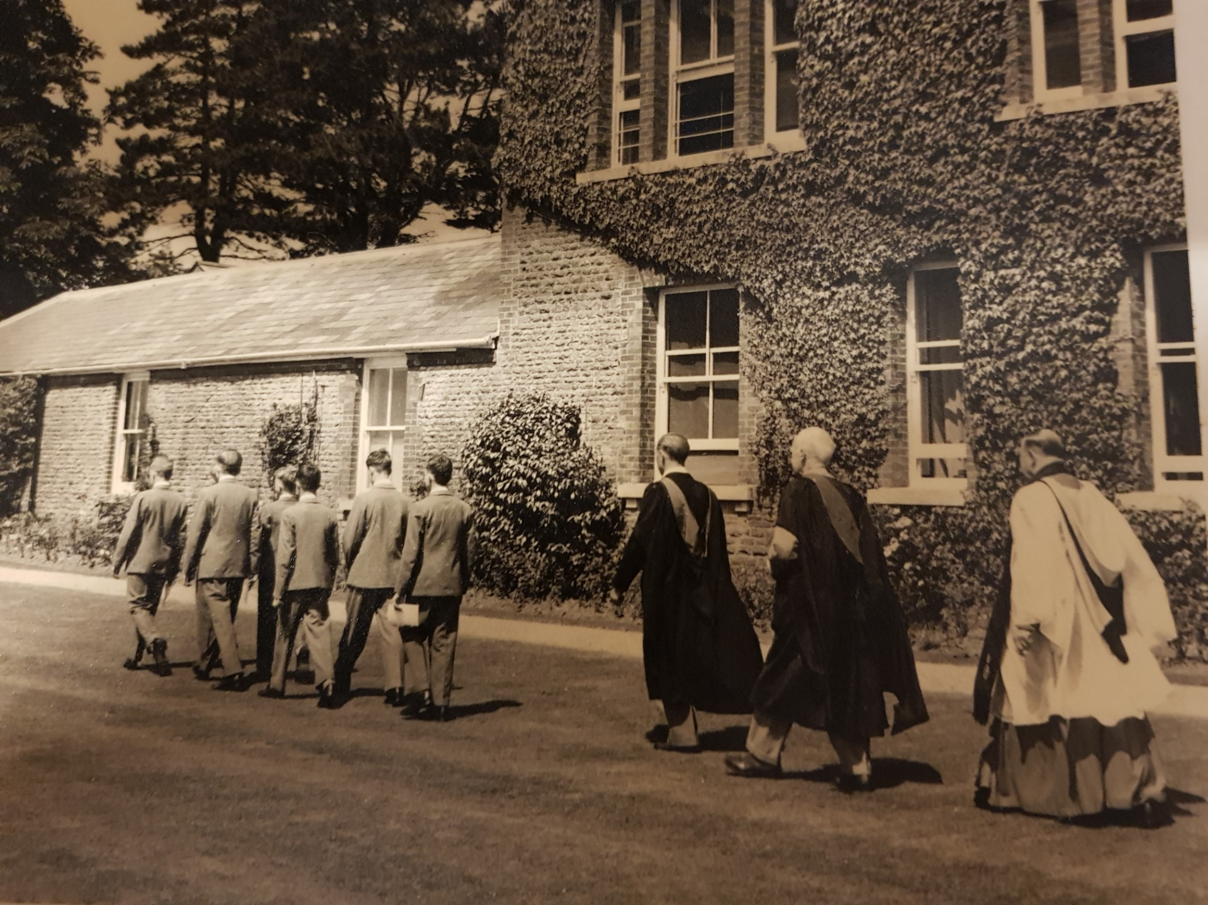
The Chapel’s Journey - Dedication

Slide 19
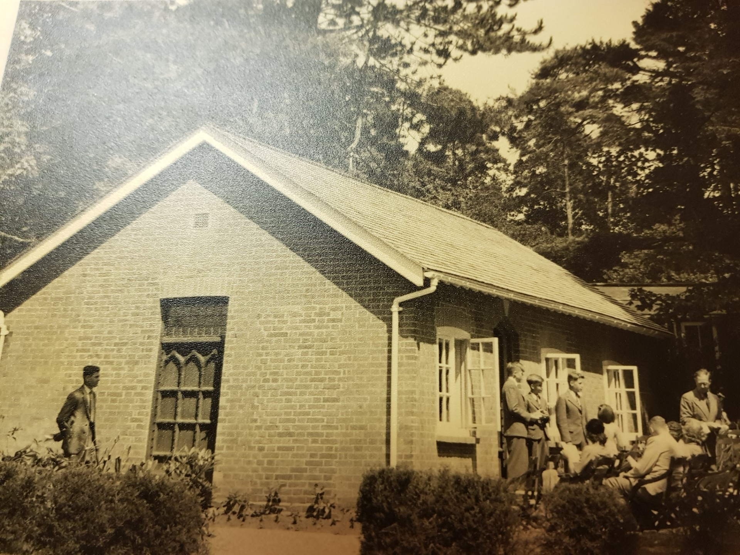
The Chapel’s Journey - Dedication

Slide 20
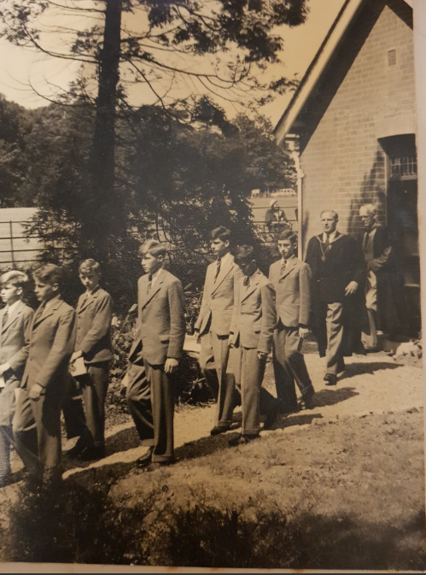
The Chapel’s Journey - Dedication

Slide 21
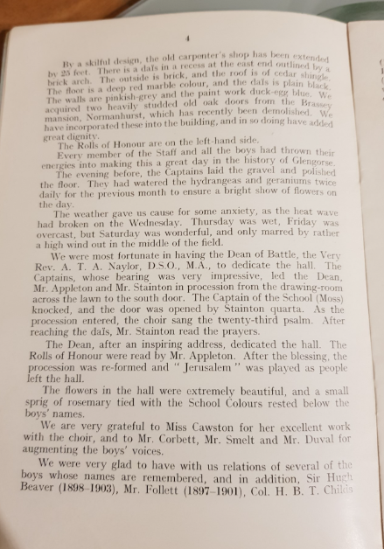
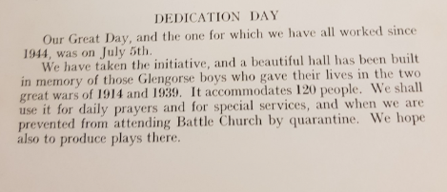
The Chapel’s Journey - Dedication

Slide 22
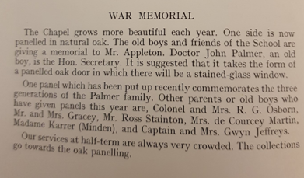
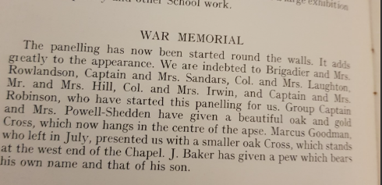
The Chapel’s Journey 1955 - 1957

Slide 23
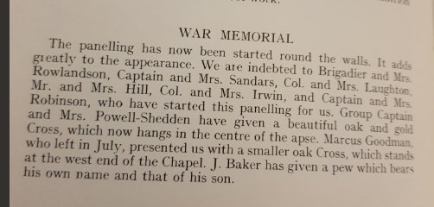
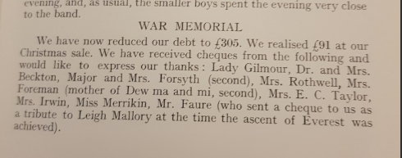
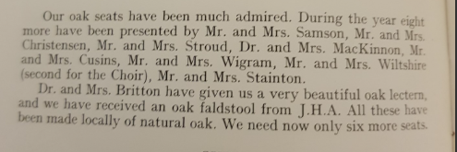
The Chapel’s journey continued.

Slide 24
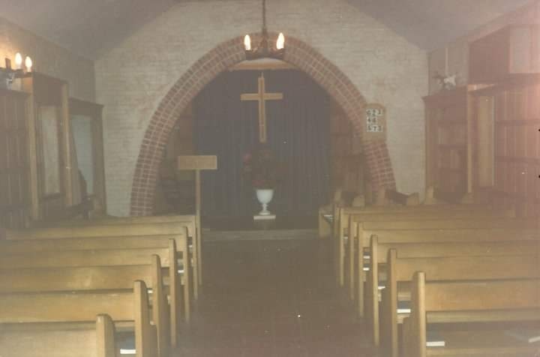
The Chapel’s Journey

Slide 25
Remembrance is not just about WW1 and WW2
It is about commemorating all soldiers who have died, in all conflicts around the world, including those happening in our time.
This week you have all been making poppies in Art, so that we can make a wreath to take to the chapel. I want to thank you all for this – as I hope you now see, it is really important that we acknowledge all those at Glengorse who came before us, to allow us to have the life and freedoms that we are privileged to have today.

Slide 26
Blessing
In a moment, we will show our respect by holding a minutes silence. Before we do, I am going to end with part of the Blessing of the chapel by the Dean of Battle, it seems fitting for some of the battles that we face in our own lives:
“Go forth into the world in peace; be of good courage; hold fast to that which is good, render to no man evil for evil; strengthen the faint-hearted; support the weak; help the afflicted; honour each other.”

Slide 27
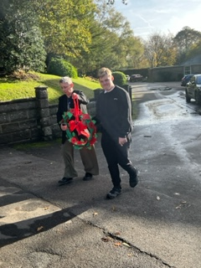
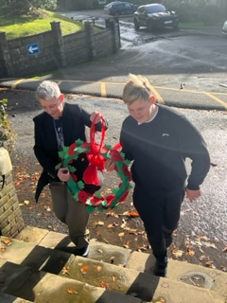
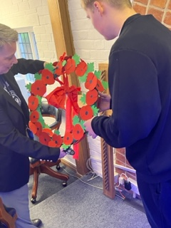
One child who is in Cadet’s, helped Amelia take the wreath to the chapel and lay it.

Slide 28
